Slide 1

MAN 4720 - Strategic Management: The Capstone Class Monday Jan 25
Brought to you by Dr. Schminke and the awesome Capstone team

Slide 2
Capstone LAST time:
Lecture
Introduction to strategy
Get to know the course structure
The financial readiness quiz (this week!)
Soft launch the first project (Industry Analysis)
Begin conceptual tools for the Industry Analysis
Labs
Introduction to the lab groups
Forming teams
Better understanding of coming attractions

Slide 3
Capstone THIS week:
Lecture
External analysis
Industry analysis
Competitive analysis
Ramping up on the first project (Industry Analysis)
Bigger quantitative readiness quiz opens
Labs
SuperQuiz 2 (Jan 11 lecture; Ch 4 pp. 117-150)
Digging into external analysis tools
Digging into the data (e.g., 10-K Magic)

Slide 4
Capstone NEXT Week:
Lecture
Strategic groups
Strategic maps
Strategy & performance
Labs
SuperQuiz 3 (Jan 25 lecture; Ch 4 pp. 151-155; Ch 2)
Strategic group mapping

Slide 5
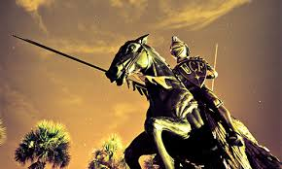
Industry & Competitive Analysis: The External Environment (OT)

Slide 6


Slide 7


What’s out there and why does it matter?
Outside your business’ walls, what keeps you awake at night?
What gets you out of bed in the morning?
What should?

Slide 8
Two acronyms; same concepts:
PESTEL: Political, economic, socio-cultural, technological, environmental (ecological), legal
STEEPG: Political, economic, social, technological, environmental, global
Differences?
STEEPG combines political and legal (I like the separation)
And adds global (but all can be local, regional, national, or global)

Slide 9
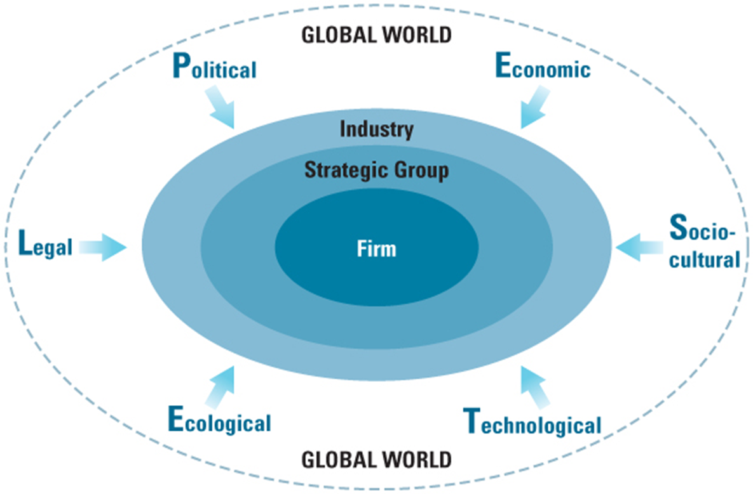
Levels of the external environment:
PESTEL
STEEPG
(Environmental)

Slide 10
External analysis:
External analysis allows you to explore the O&T side of SWOT across these layers
(Remember SWOT from other classes? We’ll review it in a few minutes)
SWOT is necessary for performing a strategic analysis of a particular firm
To do that we need some tools
PESTEL forces (bigger than just the industry)
Porter’s Five Forces (the industry itself)
(Later: Strategic Group Maps: within-industry groups)

Slide 11
External analysis: Beyond the industry (the macro-environment)
PESTEL forces
Political
Economic
Socio-cultural
Technological
Environmental
Legal
UCF Library uses PESTEL: http://guides.ucf.edu/BusinessResearch
Text (Ch 4) uses STEEPG:
Puts Legal in with Political (let’s clear that up)
Adds Global (but all can be local, regional, national, int’l)

Slide 12
External analysis: Beyond the industry (the macro-environment)
PESTEL forces
Political
Economic
Socio-cultural
Technological
Environmental
Legal
Of course, these are not razor-sharp boundaries

Slide 13
External analysis: Beyond the industry (the macro-environment)
PESTEL forces
Political
Economic
Socio-cultural
Technological
Environmental
Legal
For each: What’s happening? And…
What keeps you awake at night? (Threats)
What gets you out of bed in the morning? (Opportunities)

Slide 14
External analysis
The industry is the most proximal force
We have a framework for that: Porter’s Five Forces
Again, within each force, different Os and Ts emerge

Slide 15
External analysis:
The overriding question for all of this is whether the industry is attractive:
Is this a game we want to play?
If yes:
What do we need to take advantage of, or position ourselves against, as we move ahead with our strategic thinking and planning?

Slide 16
The search for Os and Ts within an industry isn’t random
Porter guides us in it

Slide 17
There are “Five Forces” that influence the competitive structure of an industry

Slide 18
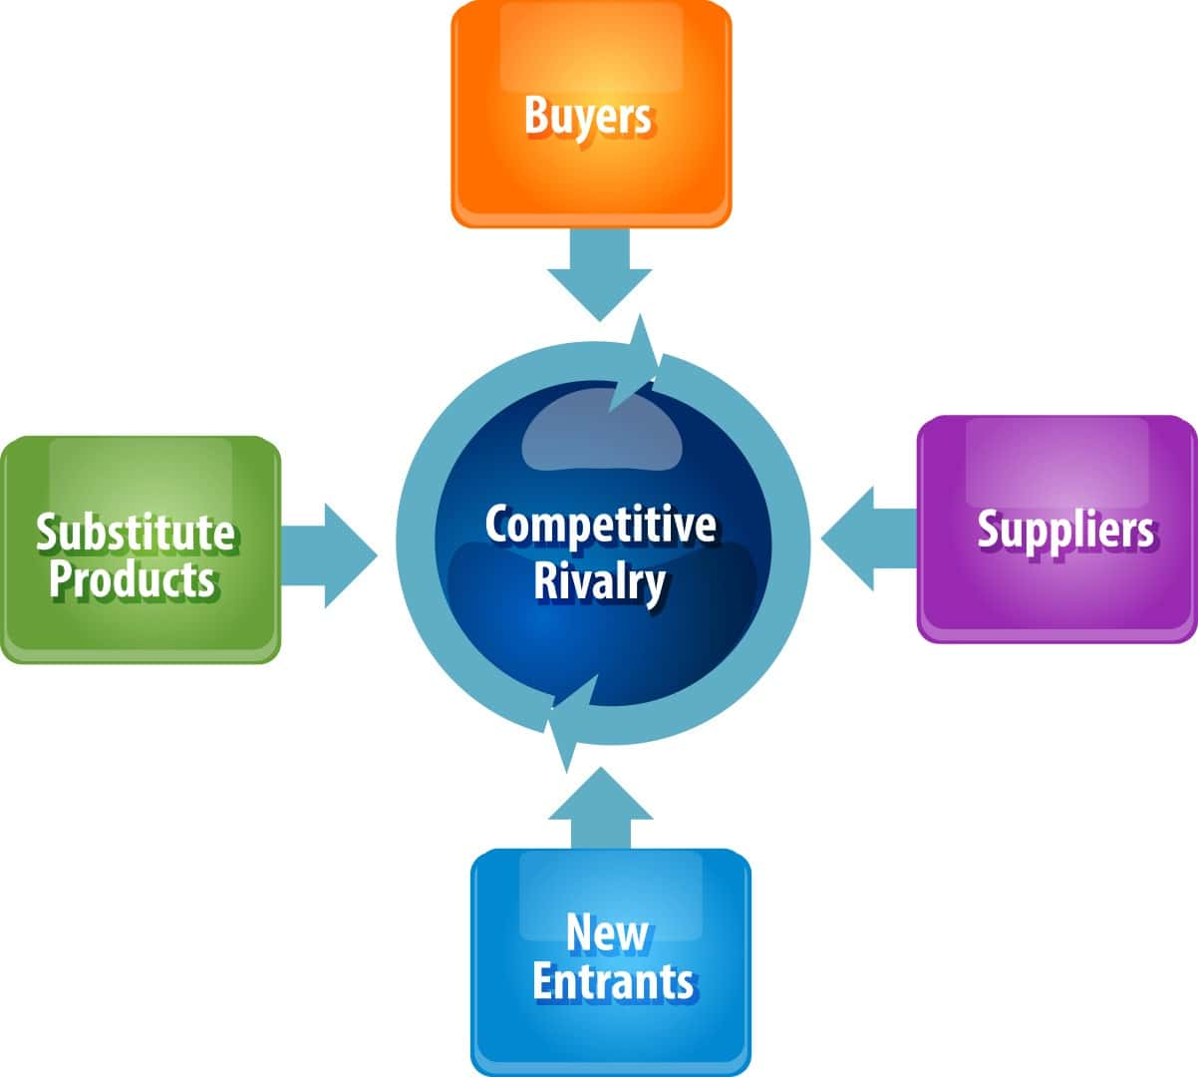
Porter’s Five Forces that
shape the competitive structure of an industry…
…and therefore, its attractiveness

Slide 19
Porter’s Five Forces of Competition
Current competitors
Potential entrants
Buyers/customers
Suppliers
Substitute products
All five matter, because each has the power to place caps on your strategic options (like pricing) and thus, industry attractiveness. Text has nice descriptions (Ch 4).

Slide 20
Porter’s Five Forces of Competition
Current competitors: Rivalry among them
Potential entrants: Threat of entry
Buyers/customers: Their bargaining power
Suppliers: Their bargaining power
Substitute products: Threat of use

Slide 21
We care about these because each of these forces represents both opportunities and threats.
Those determine industry attractiveness. So identify & catalog both, for each force.
Porter’s Five Forces that
shape the competitive structure of an industry…
…and therefore, its attractiveness

Slide 22

An interesting note:
A single firm may reside in more than one cell:

Slide 23
Note there are many companies in each of these boxes
So to do this right, you really need to “SWOT” each of them

Slide 24
MAN 4720 - Strategic Management: The Capstone Class
Brought to you by Dr. Schminke and the awesome Capstone team

Slide 25
Topic: SWOT Analysis (Peeking ahead to Ch 5)

Slide 26
SWOT analysis
Understanding companies—and their strategic situation and potential—requires that we know two things:
Who they are and what they do (both well and poorly)
Where they do it and what those conditions look like (both positive and negative)
SWOT analysis gives us the framework for doing that (see Chapter 5)

Slide 27


SWOT analysis
Strengths: Exciting stuff (internal)
Weaknesses: Worrisome stuff (internal)
Opportunities: Exciting stuff (external)
Threats: Worrisome stuff (external)
The PESTEL & Five Forces analyses put us in position to identify Os and Ts

Slide 28
SWOT analysis
Step 1: Create the big, broad list for each: Identify the top 3 Os & Ts for each of the 5 Forces, each of the PESTEL factors
Step 2: Cull that to most critical (3 Os, 3 Ts overall)
(Eventually, Step 3: Search for sustainable competitive advantage)

Slide 29



Awesome research resources
UCF library: http://guides.ucf.edu/BusinessResearch
The SEC: http://www.sec.gov/edgar/searchedgar/companysearch.html
The Bloomberg terminals in BA1 (minimal charge): http://business.ucf.edu/college/bloomberg-professional-service/

